Slide 1
Gender Analysis of Public Procurement Law 244 / 2021
By Lamia MOUBAYED BISSAT
Lebanese Parliament, 25 January 2022

Slide 2
I. Why is Procurement Reform Key to the Economy and Society?

Slide 3
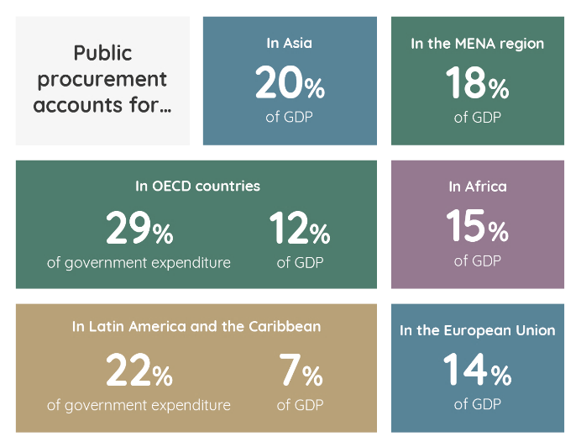
Governments are powerful change makers because they are the largest buyers in an economy
20% of public expenditures; at central level (an estimate of US$3.4 billions in 2019) (excluding public institutions & municipalities)
In Lebanon
6.5%
of GDP (4)
Sources:
OECD Data (2017)
World Bank (2017), Benchmarking Public Procurement Report
United Nations, One Planet Network
Institut des Finances Basil Fuleihan, Ministry of Finance, 2020
Notes:
Governments are the largest buyers in economies.
International reports show that low-income countries have the highest share of public procurement in GDP (14.5 %) followed by upper-middle income countries (13.6%) (2). It represents 14% of GDP in the EU (3)
Public procurement represents a substantial share of government spending and can play a key role in helping countries pursue green, resilient, and inclusive development. Government procurement spending reached US$13 trillion worldwide, or around 15% of global gross domestic product, in 2019.

Slide 4
A key enabler to achieve policy objectives
Strategic Public Procurement
Sustaina-bility
Gender
SMEs /
Innovation
Social cohesion
Digital transfor-mation
Public Procurement is a powerful tool for achieving secondary policy objectives: sustainable green growth, SMEs development, innovation, responsible business conduct, industrial policy objectives, gender mainstreaming, and digital transformation
Thinking procurement strategically means going beyond the simple fulfillment of an administrative function, it is no more a choice for policymakers, but rather a responsibility to face tremendous challenges.
Notes:
Efficient procurement procedures save time and money, opening up much needed fiscal space, yet modern public procurement can also serve as a tool for achieving broader socioeconomic policy change.
Government purchasing decisions, including more strategic use of technology, can be used to maximize value for money (VfM) as defined by a concept of “value” that goes beyond fiscal savings to include broader policy goals such as environmental sustainability, support for small enterprises, or protection of vulnerable groups in society.

Slide 5
57% of OECD countries have a framework for gender & PP
Notes:
Currently, 57% of the countries (that replied to the OECD survey) that have a framework on strategic objectives in public procurement also include gender-related considerations (OECD, 2021)
Voluntary application is more frequent, both for sub-contractors and for the supply chain. Only 7% of the countries require the application of their
frameworks on gender considerations to the whole supply chain (OECD, 2020[8]).

Slide 6
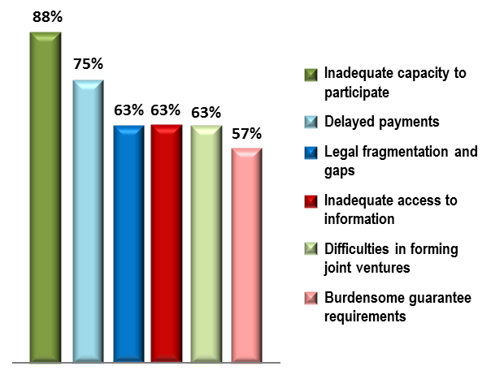
An opportunity for inclusive growth and sustainability
Obstacles for SMEs in public procurement
Government is the BIGGEST buyer
Purchasing behavior affect the conditions of competition. OECD research suggests that eliminating bid rigging could reduce procurement prices by 20% or more
Government is the BIGGEST buyer
An opportunity for SMEs and local economy (95% of enterprises, 51% of the working population
Government is the BIGGEST buyer
An opportunity for sustainable procurement
Government is the BIGGEST buyer
An opportunity for gender equality & women empowerment
Rotar, LauraJuznik, Contributions of SMEs to employment in the EU, September 2019
The Economist and UNOPS, The Future of Public Spending, April 2020
Notes:
Set technical specifications efficiently: innovative solutions are demand-driven
Efficient public procurement is key for SMEs participation
It is estimated that between US$3trn and US$5trn will be needed every year to meet the SDGs by 2030 (1).
Effective public spending can help through less wasteful and more efficient spending practices on goods and services while promoting social and environmental sustainability (2).
rages dialogue with suppliers limits companies' access to non-competitive advantages

Slide 7
Barriers facing women-led businesses in public procurement
Only 5% to 20% of the US$13 trillion spent annually on public procurement is awarded to women-led businesses, mostly in urban areas Open Contracting Partnership
Lack of knowledge of tender opportunities
Lack of access to finance
Women businesses, that are of majority SMEs, do not have timely information about procurement opportunities & procedures, which hinders their participation & capacity to grasp new opportunities.
Access is lower among smaller entrepreneurs and in sectors where majority of Women SMEs operate (trade, services, etc)
limits their ability to acquire the working capital needed to apply for government contracts.
payment delays in public procurement means that businesses need access to finance.
Perceptions of corruption or bias
Operating on a smaller scale
Women entrepreneurs believe corruption and bias impair the fairness of public procurement processes, favoring men businesses.
Preconceived beliefs that women can only lead microenterprises in certain sectors affect how women's capabilities are perceived in the bidding process.
Corruption, payment delays and inadequate regulatory framework are key obstacles to participation.
In Latin America, Sub-Saharan Africa, and East Asia, women lead, on average, 23% of small businesses compared to 11% of large businesses.
The smaller size hinders their capacity to meet the requirements of large government contracts.
Governments have difficulty to define women-led businesses and lack gender-disaggregated data about bidders and suppliers
Source: Open Contracting Partnership (2020), How to empower women-led businesses and make public procurement more inclusive
Notes:
In both developed and developing countries, women are facing tremendous challenges to accessing public contracts:
International reports pointed to main challenges:
a perception that women entertain that they are not “good enough” or “qualified enough” to enter a competitive bidding process.
they lack knowledge about how to access the procurement market and where to find opportunities .
there is a disparity between men and women participation in procurement across sectors, pointing to the need to target areas where women lag behind.
WLSMEs face administrative, financial and procedural challenges in accessing and participating in public procurement markets, due to the complexity and costliness of procurement processes, as well as high levels of corruption

Slide 8
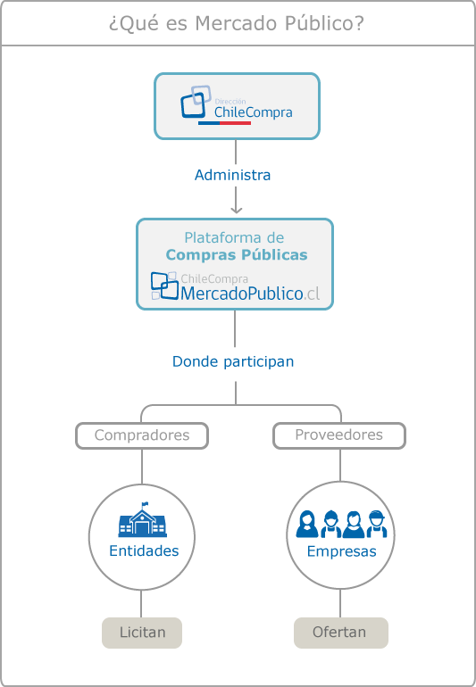
CHILE embraced gender considerations in PP since 2015
ChileCompra (through ‘mercados publicos’) helped address many common barriers that micro, small and medium-sized enterprises (MSMEs) – which most women-owned companies are – face, including very large contracts, lack of access to information, limited skills and time to prepare bids and cumbersome bureaucracy.
Since 2015, women providers were trained on how to do business with the state, on ethics and transparency.
A certification system ‘Sello Empresa Mujer’ (Women Supplier Certification) where enterprises are certified and registered in the civil registry as “female enterprises”.
RESULTS
Increase in number of women-owned businesses in PP (approx. 45% of transactions). Many of them are from rural areas and 64% are from the family’s main wage earner (OECD,2021).

Slide 9
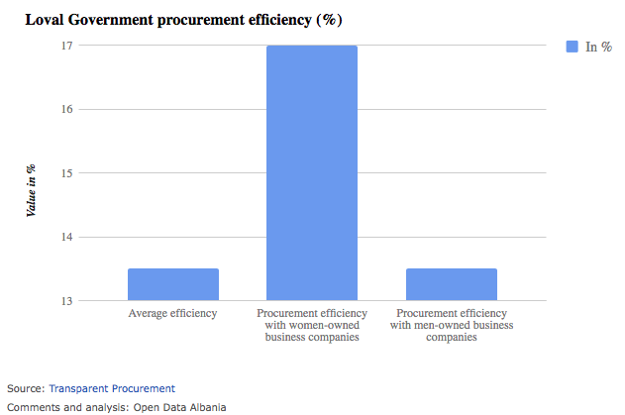
ALBANIA: Cost effective public contracts are those women-led
In Albania, 26.8% of businesses are owned by women.
BUT women’s companies account for a small fraction of the suppliers contracted by local governments.
Women-owned businesses in Albania receive 5% of municipal contracts, which accounts for only 3.2% of total municipal procurement.
Through the Open Procurement Portal, a total of 136 women-run companies were awarded contracts over 1&1/2 year period (101 fully owned by women, 35 co-owned with men).

Slide 10
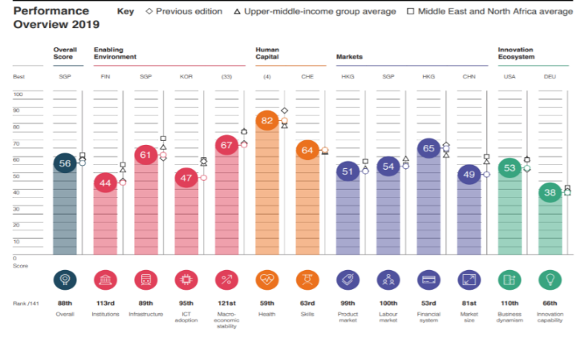
A challenging environment for women-led businesses in Lebanon
Lebanon ranks 139/153 countries in women economic participation and opportunity (Global Gender Gap, 2020).
The share of firms in Lebanon that are co-owned by women is 9.9%, concentrated in lower value sectors and struggle to grow, finding it harder to access finance and markets. (World Bank Enterprise Survey, 2019)
Economic crisis in Lebanon has multiplied the challenges facing women-led start-ups and SMEs: Growth contraction of 25% (2021); pay and retain employees, cover operational costs with a decreased demand, difficulty to access supplies.
More challenges emerged with COVID-19: disruption in supply chains due to lockdowns, and dramatic drops in sales and cash flows.
Lebanon’s economic competitiveness is declining

Slide 11
II. Law no. 244/2021: An opportunity towards gender equality

Slide 12
A modern procurement law in line with intern’l standards
POLICY PROCESS
Evidence-based exercise to identify the level of performance of the current procurement system through the MAPS Assessment
Leveraging on previous laws and draft laws prepared at the national level to preserve national efforts
Based on the UNCITRAL Model Law on Public Procurement (2011) and the OECD Recommendation on Public Procurement (2016)
Benchmarking against other MENA countries’ procurement laws, namely Jordan (2019), Egypt (2018), Palestine (2014) and Tunisia (2014)
Technical guidance & assistance from the World Bank and the EU-OECD SIGMA joint initiative.
PRINCIPLES
Efficiency & competition
Integration
Accountability
Accountability
Accountability
Inclusiveness
Inclusiveness
Sustainability
Sustainability
Sustainability
Transparency
Transparency
Professionalization
Integrity
OBJECTIVES
Applying competitive methods as a general rule
‎Providing for equal opportunities to participate in public procurement
‎Providing for fair, equal and equitable treatment of all bidders and contractors
Ensuring integrity & professionalism of procurement proceedings to enhance control & accountability
‎Promoting local economy development, national employment and production, based ‎on the best value for spending public funds‏

Slide 13
Gender analysis of Law 244/2021
Although not explicit on gender considerations, Law 244/2021 provides all legal foundations necessary to inspire a transformative conceptualization of gender-responsive procurement policies that support both equal market opportunities for women’s enterprises to access public markets, and equal outcomes for women in the labor market.
It allows the setting up of a GRP ecosystem, prerequisite for the transformation, and paves the way for concrete ways to make this vision a reality, through:
I. Enhanced competition frameworks
II. Observed sustainability
Transparency & integrity standards across the board

Slide 14
Enhanced framework for competition
Law 244/2021 includes provisions that contribute to guaranteeing equal and fair opportunities to all potential suppliers to participate in procurement on competitive basis through:
Ensuring that competitive measures are the general rule and the standard procurement method, as a means to enhancing efficiency and fighting corruption; this was not the case previously.
Adopting strict controls to limit the recourse to mutual agreements
Working within coherent, stable, clear and simple institutional, legal and regulatory frameworks which ensures that potential competitors of all sizes have access to procurement opportunities, including foreign suppliers, and promote fair, equitable and transparent treatment of all
Providing equal opportunities for all bidders wishing to participate in the pre-qualification proceedings according to a clear and detailed process allowing to determine the bidder’s eligibility and capacity to implement the contract. This replaces an old and archaic “classification” process that was ill governed and acted as a barrier for entry of new comers into the public markets.

Slide 15
Sustainability is a key guiding principle
Law 244/2021
Provides a leverage for economic development, by ensuring SMEs the right to fair and transparent participation in government contracts, and including sustainability criteria related to environment, balanced economic development (support of women’s economic participation, rural development, etc.), and social responsibility;
Directs the Lebanese government procurement capacity, when possible, towards sustainable goods and services, while ensuring a balance between potential benefits and achieving the best value for money;
Provides incentives to SMEs, local production and national expertise;
Allows for procurement to be divided into lots, when possible, to guarantee social & economic benefits;
Provides preference regulations with regard to domestic products, consulting services and expertise, and guarantees that such products, services and expertise shall not be excluded if they are available and their quality thereof meet technical requirements;
Uses clear, integrated and standardized bidding documents, binding for all parties;
Provides an appropriate range of procurement methods that include competitive procedures, to ensure best value for money and only eligible bidders are involved.

Slide 16
Articles’ analysis
Article 7: Conditions of Bidders Participation
II - Qualifications of bidders: The procuring entity shall establish no criterion, requirement or procedure with respect to the qualifications of bidders that discriminates against or among bidders or against categories thereof, or that is not objectively justifiable.
ANALYSIS The country has an uncompetitive procurement track record where 60% of total CDR spending (2008-2018)—or $1.9 billion—was granted to only 10 companies, owned and mostly led by politically-connected figures reflecting favoritism and unbalanced market conditions. Articles 7 ensures that no discriminative criteria exist between bidders, ultimately making the public procurement process a fairer one. It will take a long time to regain trust in the system and for women and men to test the impartiality of the new public procurement procedures in Lebanon.

Slide 17
Articles’ analysis
ANALYSIS Procurement planning is a practice that helps the procuring entity better forecast its future needs and inform the market about them. Within the planning exercise, the procuring entity may consider pursuing specific policy goals and objectives such as gender mainstreaming or environmental sustainability. It is during the planning stage that procuring entities may harness the power of public procurement to shape markets to promote women’s entrepreneurship and economic empowerment. Procurement planning proceeds the preparation of the budget and thus allows the budgeting exercise to become an opportunity for reflecting on gender-equitable distribution of resources.
Article 11: Procurement Planning
2. The procuring entity shall determine its needs and prepare its annual plan for the coming year while planning its expenditures. The estimated total value shall be determined in accordance with the funds required in its budget proposal. (…)
A plan can be annual or multi-year in case it involves projects that require scheduling commitments in a medium- or long-term framework,…

Slide 18
Articles’ analysis
ANALYSIS WSMEs in Lebanon were excluded from the procurement market because allotment was not permitted, and large suppliers favored. Allowing for the division of procurement into independent lots ultimately increases the number of public procurement opportunities available for WSMEs to participate. It makes it possible for small businesses to submit bids for the specific lot that is within its capacity and area of specialization. Allotment is to be used when a development policy is to be applied; it may serve gender-responsive policies.
Article 14: Division of the procurement into lots
1. A procuring entity is entitled to divide the procurement into independent portions only in the following two cases:
a. Where the nature of works, goods or services requires such division and where there are clear justifications. b. When implementing government development policies (participation of SMEs in public procurement)

Slide 19
Articles’ analysis
Article 15: Sustainability and development policies
1. Where possible, procuring entities shall adopt SPP to direct the procurement power of the State towards sustainable goods and services (…) while ensuring a balance between the potential benefits and achieving the best value of spending public.
2. Where possible, bidding shall be made on the basis of lots, and the bidding documents shall specify the number and nature of such lots or groups and the requirements for participation in a lot or group of the procurement and the manner in which the contract is awarded, for the purpose of guaranteeing social and economic benefits. The sustainable public procurement rules and policies shall be set by decrees issued by the Council of Ministers.
ANALYSIS Article 15 recognizes the need for the public sector to constantly pursue sustainable development policies when it comes to public procurement operations (using procurement in a strategic way to support women’s enterprises through for example a “buy from women-owned” approach, focusing on enterprises certified to be owned or led by women.) Secondary legislations may be developed to: setting aside 20% of PP for women-owned businesses opening PP opportunities for targeted sectors where the concentration of women-led & owned businesses is high setting tax exemption policies for WSMEs winning public contracts. To maximize the benefits of such practices, they need to be regulated through decrees to be issued by Council of Ministers at the suggestion of the Public Procurement Authority.

Slide 20
Articles’ analysis
Article 70: Subcontracting
2. For contracts of works and services, if the bidding documents so authorize, the contractor may contract a subcontractor to execute part of the contract within the allowed percentage thereof specified in the bidding documents, provided that such percentage does not exceed 50% of the contract value (…)
ANALYSIS Article 30 supports the increased participation of small businesses. By making it possible for the main contractor to subcontract another contractor to execute a different part of the project/contract as long as it does not exceed 50% of the total contract value. This article provision gives the possibility for women-led businesses to work on and deliver a specific part of the project that is within their capacity and area of specialization. Article 30, similar to Article 23, is also beneficial in the case of local governments to encourage local businesses operating on a small scale to participate and give them a chance to access a steady stream of profit which they could then re-invest into their businesses.

Slide 21
Articles’ analysis
Article 41: Procurement methods
1. The procuring entity may conduct procurement by means of:
Open tender
Two-stage tendering
Request for quotations
Request for proposals for consulting services
Direct contracting
Shopping (or by invoice)
2. The procuring entity may engage in a framework agreement procedure in accordance with the provisions of Section 8 of this Chapter.
ANALYSIS Competitive procedures are the general rule to secure efficiency, equal and fair opportunities for all bidders, fight corruption, limit mutual agreements and introduce new and modern procurement methods. Article 41 Introduces a comprehensive range of procurement methods, proportionate to the nature and value of the contracts to be concluded, in the aim to increase competition. 3 new procurement methods are introduced & explained: two-stage tendering, request for proposals, and framework agreement. However, these methods need to be explained well to SMEs and WSMES so that they have a good understanding of their conditions and requirements and would succeed in preparing successful bids. A guide to SMEs/WSMEs is of utmost necessity. Also, a hands-on training program dedicated to help them prepare winning bids.

Slide 22
Articles’ analysis
Article 66: Electronic procurement system
The Public Procurement Authority shall establish and operate a central electronic platform for public procurement using digital information means and technologies to meet the needs of the procuring entities for goods, works and services. The e-procurement platform shall include an electronic registration mechanism that allows suppliers, contractors, consultants and service providers to register online to be eligible to participate in electronic public procurement. (…..)
ANALSYIS This Article establishes, for the first time in Lebanon, a digital solution to be used in procurement operations (central electronic platform) which is in line with the principles of transparency and integrity. The central electronic platform, and in the future a full e-procurement system, ensures easy access to information, which is beneficial to SMEs, including WSMEs, that usually struggle to access information about public procurement opportunities. E-procurement ensures transparency, efficiency and accountability all of which are principles that push Lebanese women led businesses in particular and SMEs in general who were skeptical and distrustful of the traditional system.

Slide 23
Articles’ analysis
ANALYSIS Discrimination and unfair treatment can many times be caused by the misapplication of laws and not the laws themselves, which is why awareness and training on the new law is important especially when it comes to respecting the principles of competition, efficiency and sustainable development. Article 72 aims to professionalize public procurement in Lebanon across government through mandatory and continuous training. It stipulates directing part of the training to the private sector in an effort to strengthen their ability to implement the law with high integrity standards. This clause is an excellent entry point to target women-led businesses by customizing training programs that answer their needs and prepare them to better understand the new dynamics of the procurement market so that they prepare their businesses to enter the competition. Aligning the training with the sustainable development goals is key for both the supply and demand sides of public procurement. This is NOT clear in the law and merits further emphases.
Article 72: Professional training
Part of the training may be addressed to the private sector.
The training shall include programs to enhance the integrity of procurement officers in public and private sectors (…)
6. The training shall include supporting the implementation of the Sustainable Development Goals.

Slide 24
Articles’ analysis: Public Procurement Authority
Article 76 lays out the duties of the Public Procurement Authority (PPA) and establishes it as the regulatory body responsible for supervising the performance of the PP system in a way that ensures compliance with the Law and alignment to international standards & good practices. This regulatory function is generally conducive to broad participation of the private sector, including SMEs and more particularly WSMEs, due to the signals of trust it gives.
Duties of the PPA that particularly impact gender equality and women-led businesses participation are tackled through:
Formulate tailored procurement policies
Design strategies & recommendations to increase or improve the participation of SMEs, with room for gender inclusiveness through particular consideration to women-led businesses: continuous dialogue, regular analysis of barriers to entry, etc
Adopt policies for setting aside a certain % of annual PP contracts to women-led business
Allow systematic & free of charge access to information through the central electronic platform
Publish procurement data; an opportunity to publish & analyze gender-disaggregated data
Assist & advise WSMEs on how to seize procurement opportunities

Slide 25
Main actions to be undertaken
I. At level of Government, upon suggestion of PPA
II. At level of Public Procurement Authority
Issue procurement policies in favor of socio-economic development.
Issue secondary legislations on setting aside 20% of public contracts for women-owned businesses, opening PP opportunities for targeted sectors where concentration of women-led & owned businesses is higher or setting tax exemption policies for WSMEs winning PP contracts
Consider gender equality in the secondary legislations establishing the PP profession.
Consider gender equality in the secondary legislations for PPA and CA formation
Establish a code of conduct, by virtue of a regulatory decision, based on the standards of integrity, transparency & prevention of conflict of interest
Establish and operate, without delay, the central electronic platform, and engage women-led businesses in testing & training.
Evaluate, monitor and adjust applied policies.
Simplify the systematic and timely access to bidding documents on the central platform.
Issue explanatory guidelines on procurement methods.
Observe SDGs in the procurement training policy to be issued.

Slide 26
Main actions to be undertaken
III. At level of procuring entities
IV. At level of Institut des Finances
While planning, consider pursuing policy goals & objectives such as gender mainstreaming or environmental sustainability, to promote the development of women’s entrepreneurship & economic empowerment.
Divide procurement into lots for small businesses to submit bids within its capacity & specialization.
Be open to change; to applying new inclusive PP policies in favor of gender & development.
Provide awareness and training to women-led businesses on the new law to ensure respecting the principles of competition, efficiency and sustainable development.
Target women-led businesses by customizing training programs that answer their needs and prepare them to better understand the new dynamics and to enter the competition (new methods, etc)
Provide training programs on framework contracts for WSMEs to learn how to submit bids and manage them successfully.
Aligning the training with the SDGs and gender responsive procurement.

